Slide 1
Stochastic Shortest Path in Maze
Rudra Sarkar | Shivang Modi
CB.EN.P2AIE22009 CB.EN.P2AIE22007

Slide 2

Path Finding
Given a maze and an agent, find the shortest route which will lead the agent to the exit/ goal

Slide 3
Search
Explore everything!

Slide 4
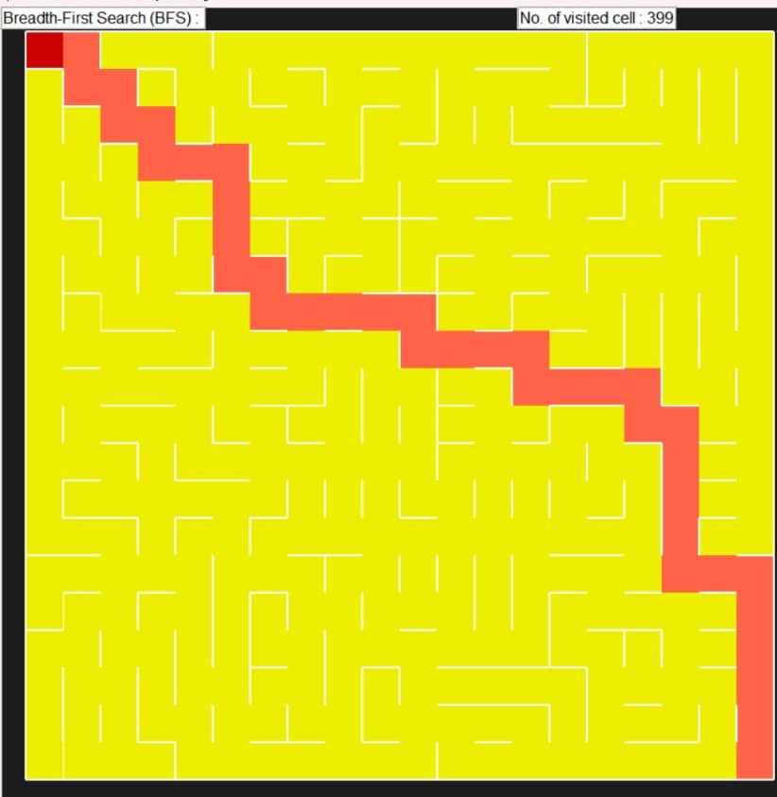

Slide 5
Search
Explore everything!
Is it Smart?

Slide 6
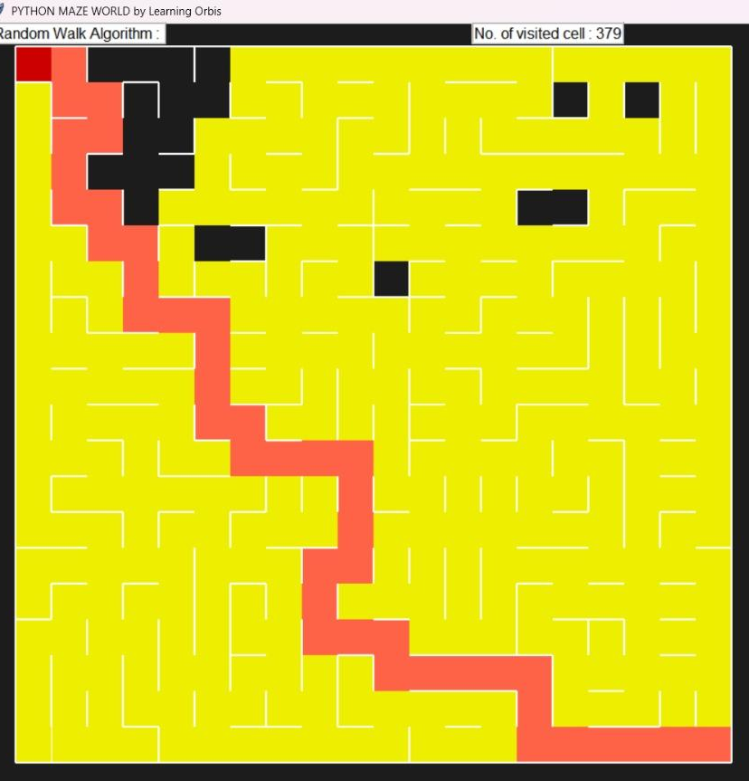

Slide 7
Heuristics
Don’t just guess !

Slide 8
Heuristics
Don’t just guess !
Make it Count

Slide 9
goal
distance
start

Slide 10
goal
G2
G1
2
C2
1
start
C1

Slide 11
A *
BB + Best First
Make a move but remember the history!

Slide 12
A *
F (n) = g(n) + h(n)
Make your moves count !

Slide 13
Where is the stochasticity?

Slide 14
Where is the stochasticity?
Randomness?

Slide 15
Where is the stochasticity?
Randomness?
Uncertainty?

Slide 16
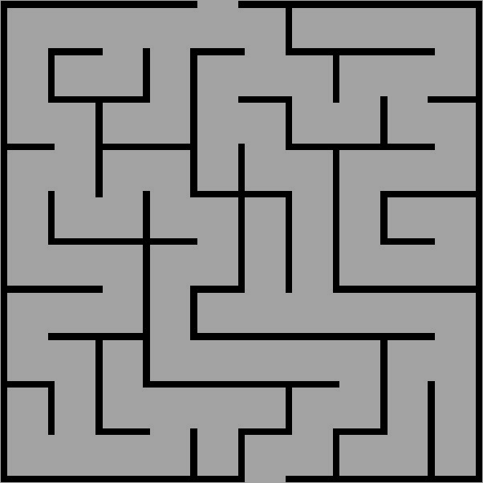

Slide 17
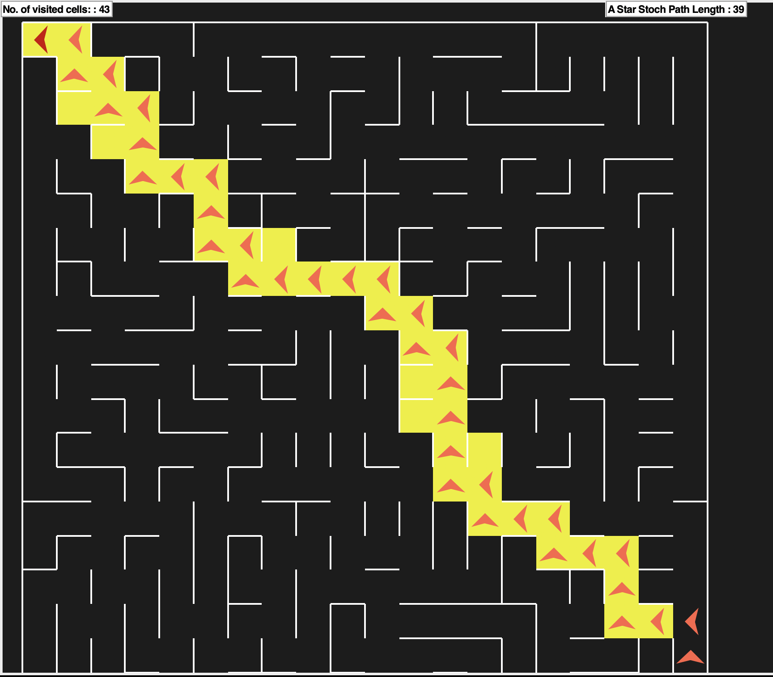

Slide 18
So clearly
Path length and
No. of Visited cells of A* is the Least

Slide 19
So Stochasticity adds a bit of Asymmetry which is actually Helpful

Slide 20
Thank You

